Slide 1



Slide 2
MEDSCORE
MEDSCORE is a comprehensive health monitoring solution, which provides predictive signals to users on the basis of their ‘MedScore’

Slide 3
TEAM - ERROR 401
TEAM MEMBERS
NOEL ELDHO
AMAL KRISHNA N M
DEEPAKLAL T A
ROY JOSE VETTIYADEN

Slide 4
PROBLEM STATEMENT
Unstructured health information of a user is currently scattered in silos
Multiple devices that track health related information that does not talk to each other
Easier access to personalized health related recommendations a currently restricted to a few

Slide 5
OUR PRODUCT
Centralized portal to consolidate all of an user’s health related information
Indicative proxy for the user’s heath basis the individual’s health data - MedScore
AI driven analysis of the data for risk prediction and early warnings personalized for each user

Slide 6
BUSINESS MODEL
B2B
White-labeled health portal for employees
Aggregate health indicators for the work force
Option for employees to create family profiles
B2C
Centralized portal to store all health-related information
Personalized early warnings
Curated insurance product suggestions

Slide 7
B2B PITCH
White-labeled health portal for employees
Data collection from annual health checkups conducted by companies
Customer portal made accessible to each employee for their consumption
Option to create family profiles for dependents that are covered under the group employee insurance policy
Aggregate lever health score created for the workforce which can be leveraged for negotiations on group insurance policy premiums
Encourage a healthy lifestyle within the workforce through gamification

Slide 8
B2C PITCH
Single portal to keep track of all health records
Early warnings and risk predictions on the basis of the individual’s health records
Health indicator in the form of MedScore
Personalized insurance bundles with exclusive benefits on the basis of MedScore

Slide 9
REVENUE MODEL
Per user fee for B2B
Subscription based FREEMIUM model for B2C
Issuance commission from insurance companies

Slide 10
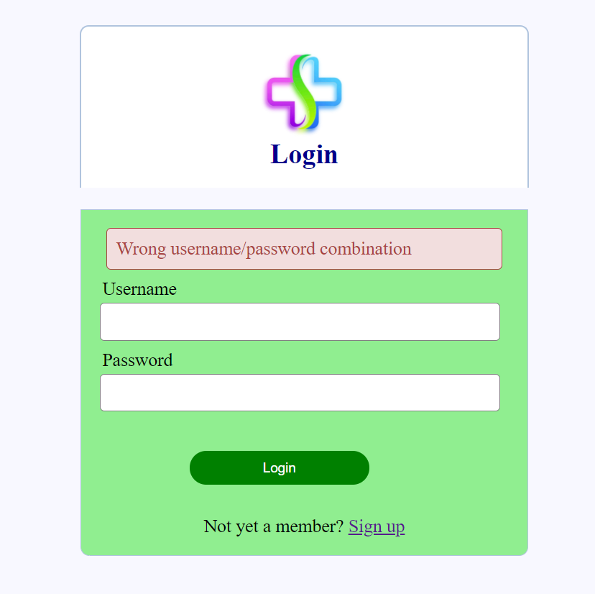
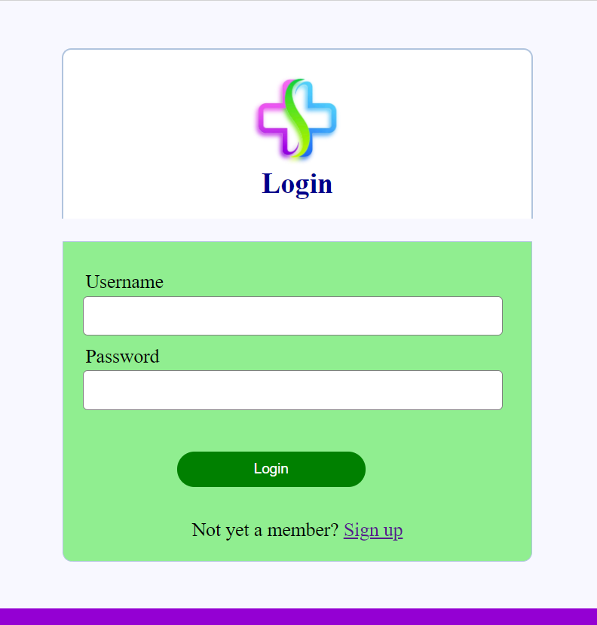
WEBPAGE

Slide 11
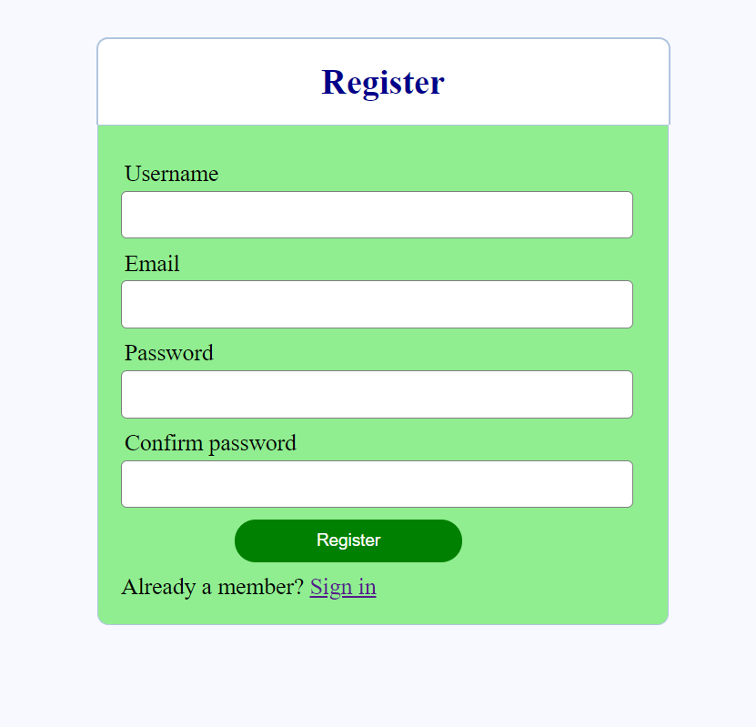
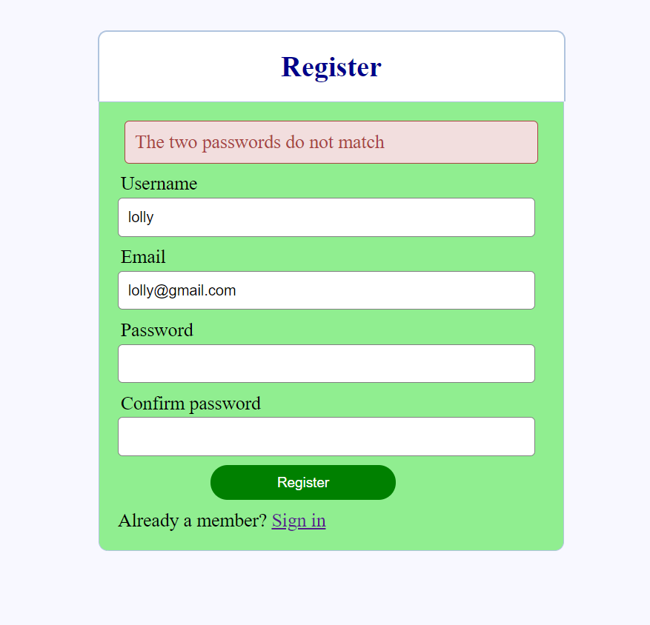

Slide 12
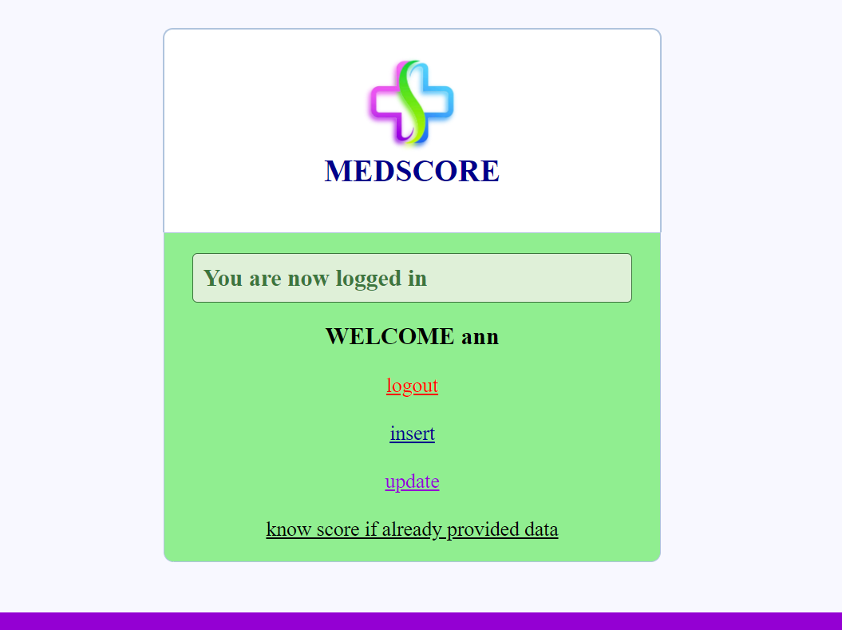

Slide 13
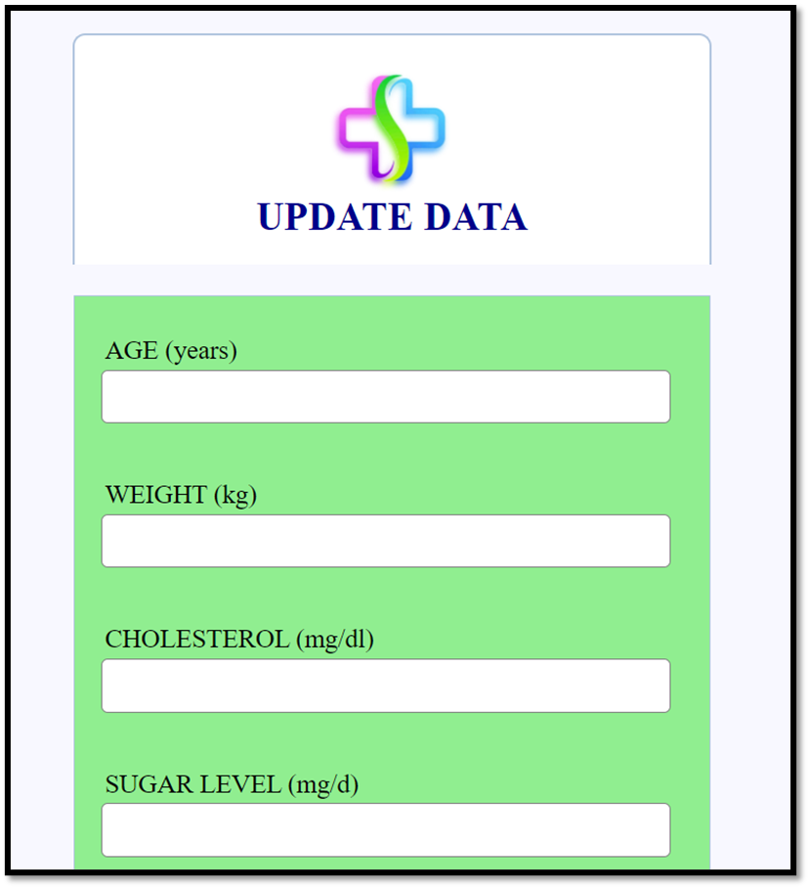
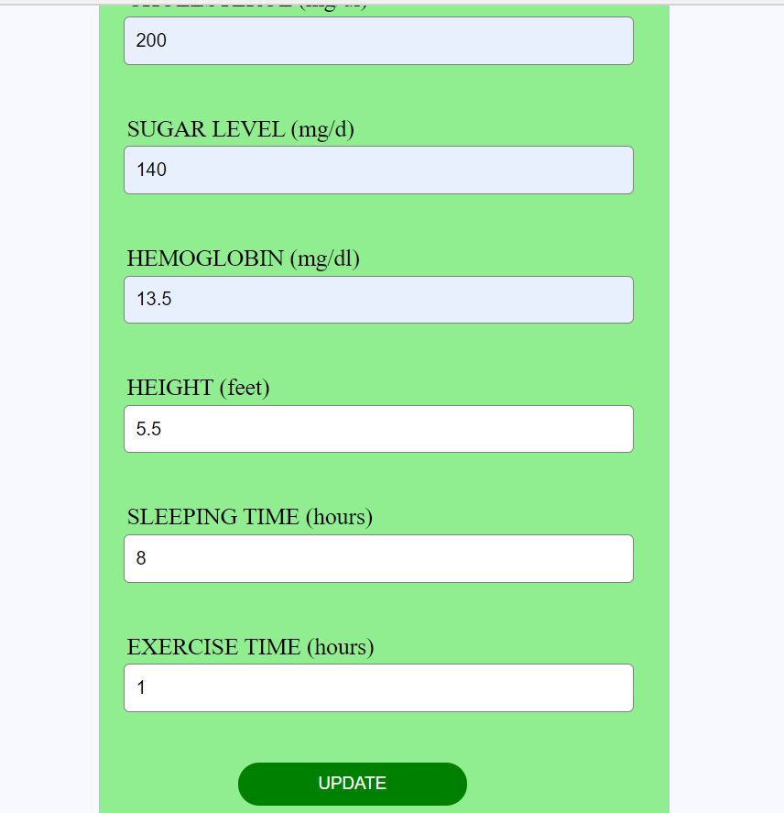

Slide 14
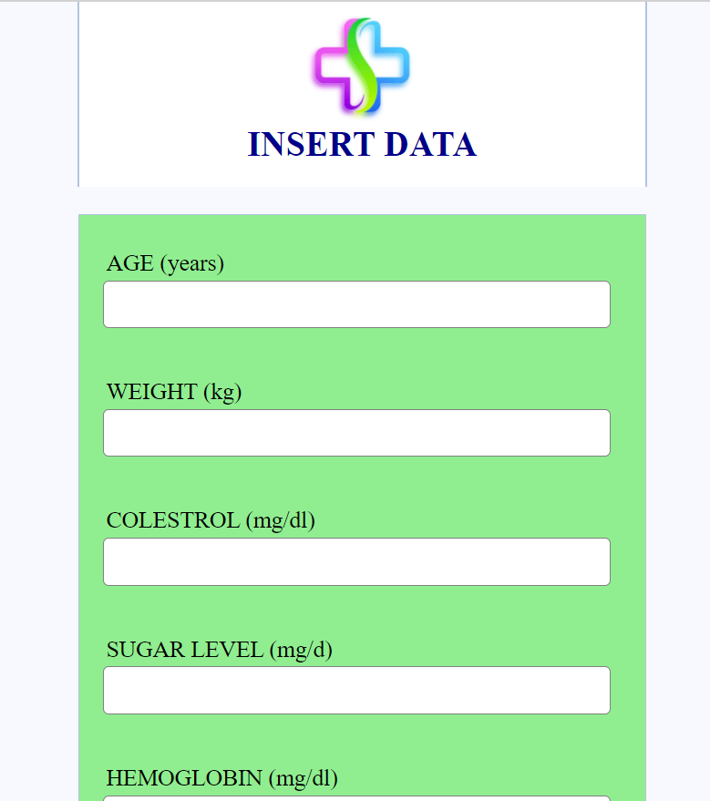
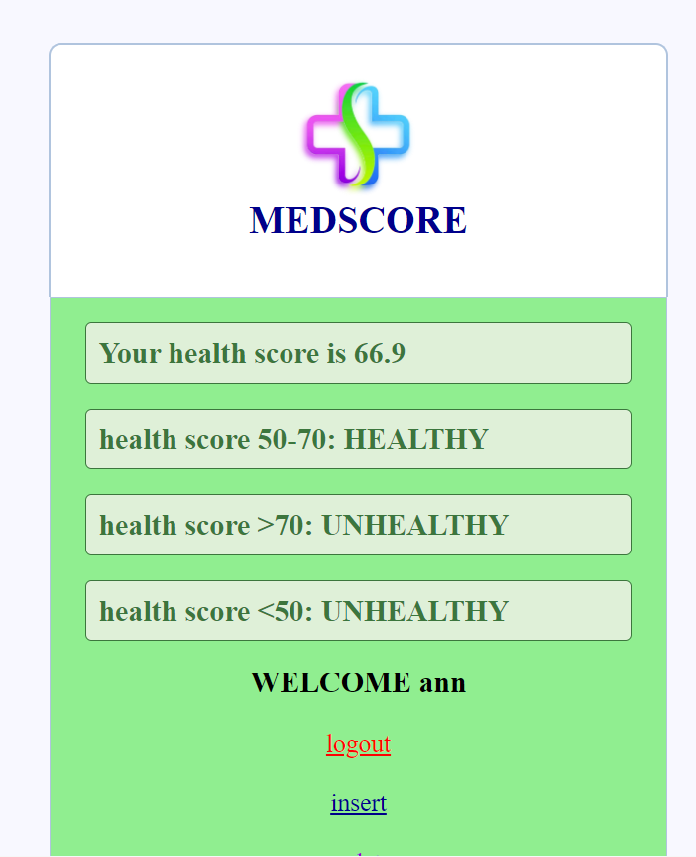

Slide 15
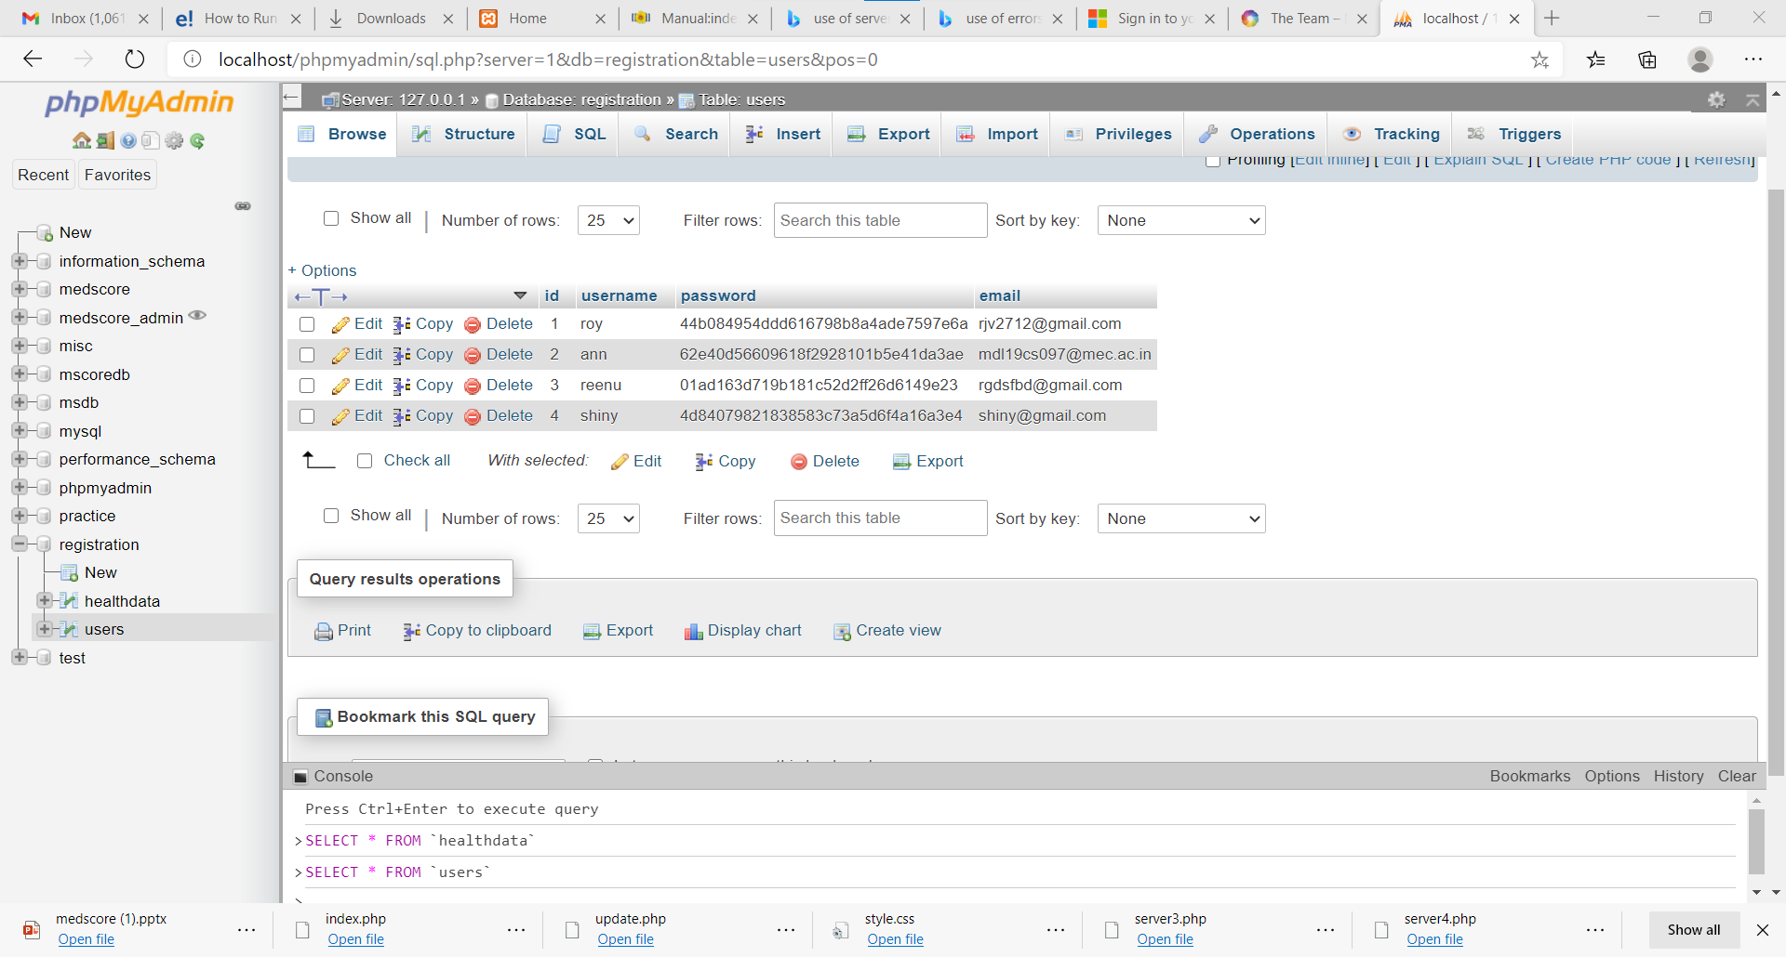

Slide 16
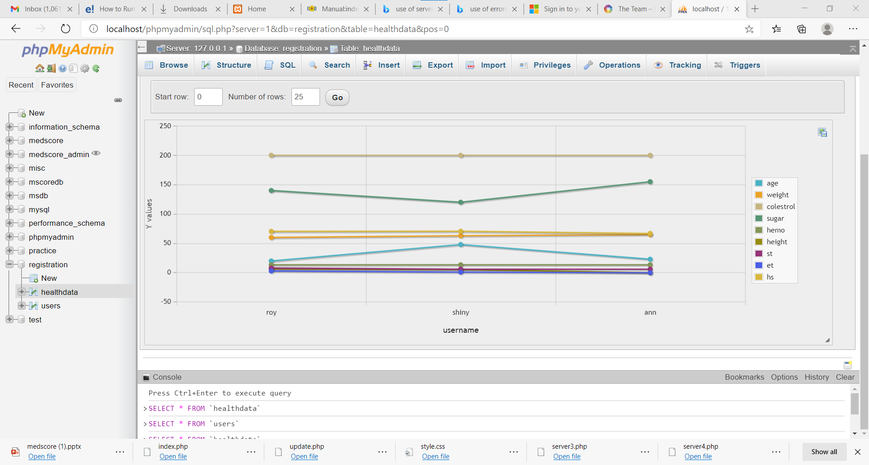

Slide 17
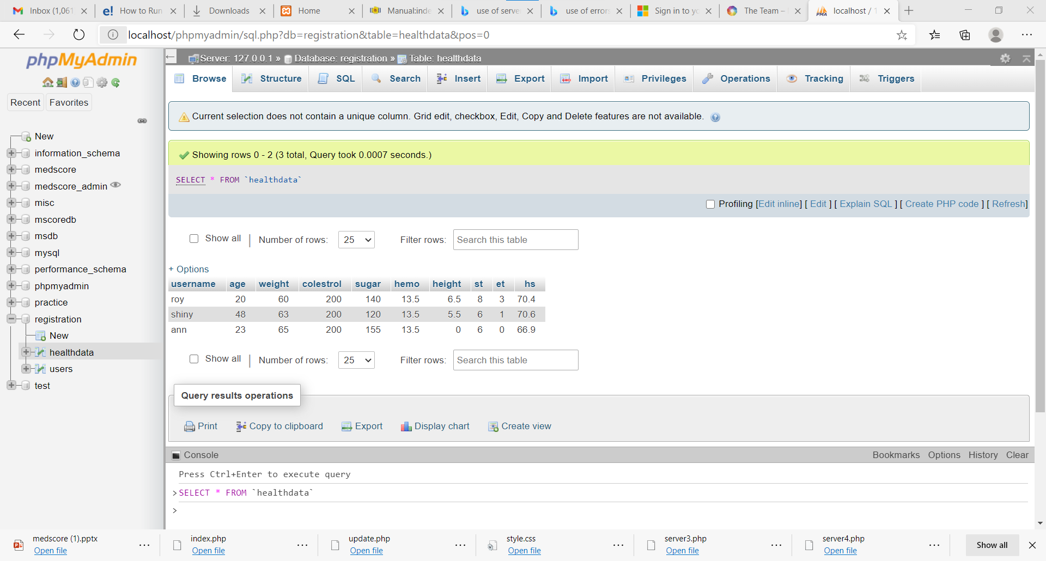

Slide 18

medscore@gmail.com
ERROR 401

